Slide 1
It’s hump DAY!! – 1/7/15
Bell Ringer
SSR
Learn about Georgia O’Keefe
Haiku
Protest and Poetry – Let’s Write!!
Topic: Haiku
Learning Goal: Effective writers are able to capture a moment through expressive language.
Essential Question: How are writers successful?

Slide 2
BELL RINGER
If you were an artist, what kind of art would you make and why?

Slide 3
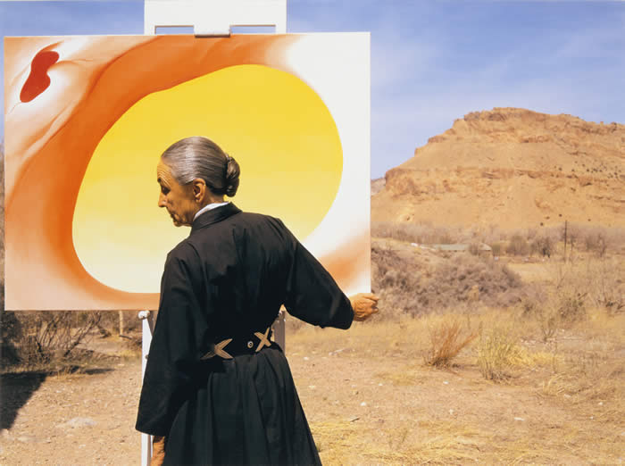
Georgia O’Keeffe
What can you predict about this artist?

Slide 4
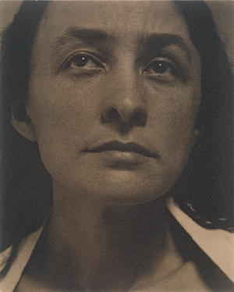
Georgia O’Keeffe
O’Keeffe’s artwork has been called “wild energy?”
How can art contain
“wild energy?”

Slide 5
Georgia O’Keeffe
Some of O’Keeffe’s subjects:
lush, overpowering flowers
sun-drenched landscapes
open skies
bleached bones of animals long gone

Slide 6
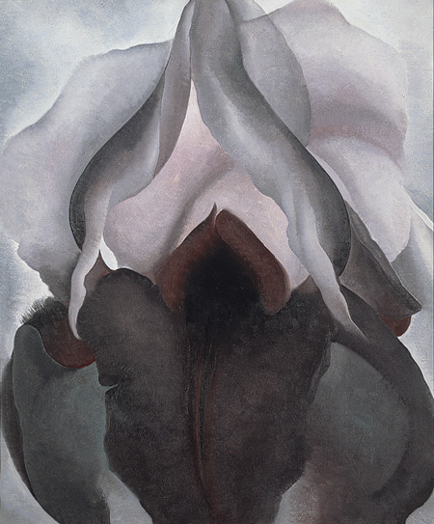
“Lush, Overpowering Flowers”
“By enlarging the petals to
over-life sized proportions,
O'Keeffe forces the viewer
to confront what might
otherwise be overlooked and,
in turn, elevates the ordinary
to the extraordinary.“
(www.metmuseum.org)
“Black Iris” (1926)

Slide 7
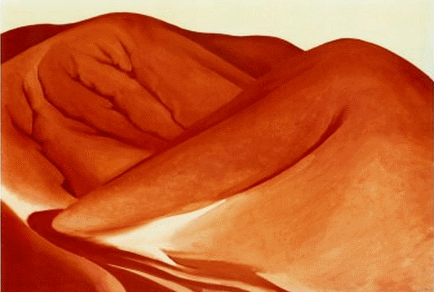
“Sun-Drenched Landscapes”
“The images were drawn from her life experience and related either generally or specifically to places where she lived.”
“The Red Hills, Grey Sky” (Near Lake George, NY)

Slide 8
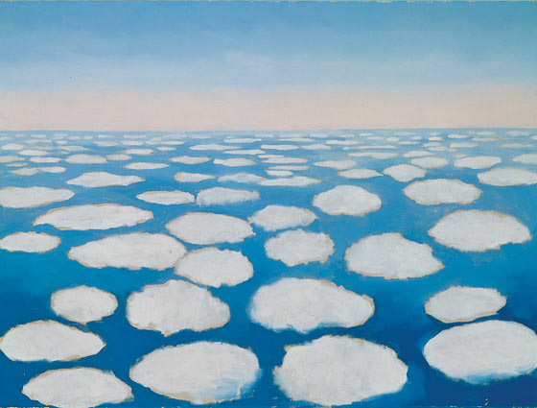
“Open Skies”
“Sky above Clouds IV” (1965)
“Traveling around the world, {O’Keeffe} was exhilarated by the views seen from an airplane window. She described the changing patterns and colors as "breathtaking" and was moved to interpret these sights and feelings in paint.”

Slide 9
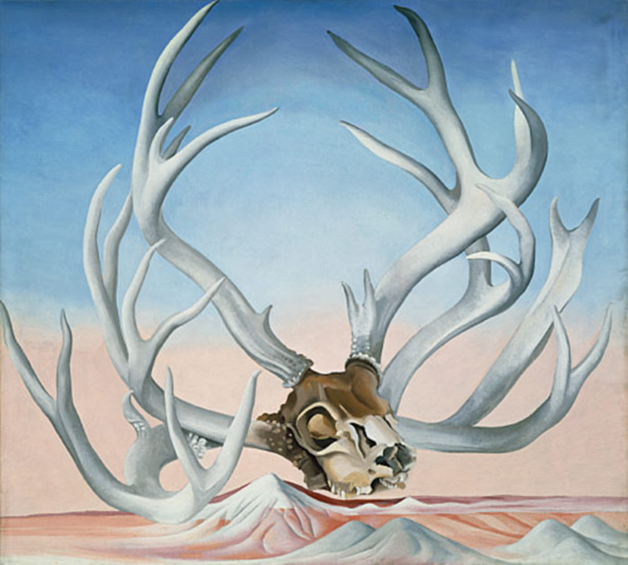
“Bleached Bones of Animals Long Gone”
“From the Faraway, Nearby” (1938)
“Rather than signifying death, O'Keeffe said that the bones symbolized the eternal beauty of the desert.”

Slide 10
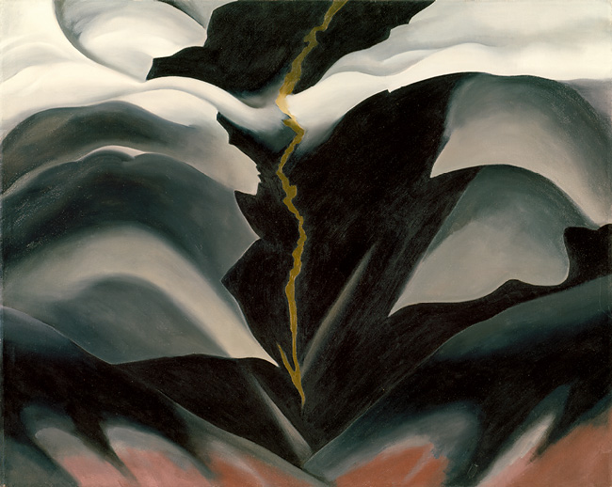
Georgia O’Keeffe’s Favorite Place to Paint
Located in the Bisti Badlands in Navajo country, about 150 miles northwest of her home in Ghost Ranch, it was a stretch of desolate gray and black hills that the artist said looked from a distance like "a mile of elephants."
“The Black Place II” (1944)

Slide 11
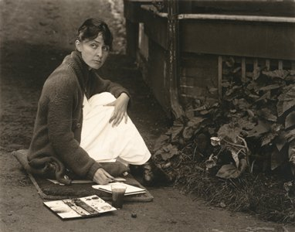
Why did O’Keeffe choose simple subjects for her art?

Slide 12
A Quick Switch to Haiku!
Background question: What is haiku?
Prediction: How may haiku and Georgia O’Keeffe connect?

Slide 13
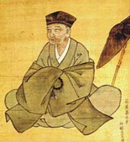
A Brief History of Haiku
Haiku originated in 17th Century Japan and was a popular pastime in the Japanese culture. Buddhist monks made haiku a “mindset, a way of living.”
Basho, the monk, (1644-1694) was famous for his haiku.

Slide 14
Haiku History and Form
How does the very form of Haiku relate to Buddhism?
“Simple directness”
“Instantaneous perception”
How does this haiku show these qualities?
Deep in a windless
wood, not one leaf dares to move . . .
Something is afraid.
--by Buson

Slide 15
“Simple directness” “Instantaneous perception”
Read the poem below to find examples of these qualities:
After the moon sets,
Slow through the forest, shadows
Drift and disappear.
by Buson

Slide 16
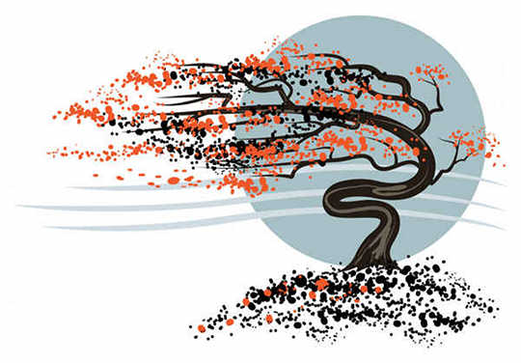
Haiku . . .
“have been described as the poem of a single breath.”

Slide 17
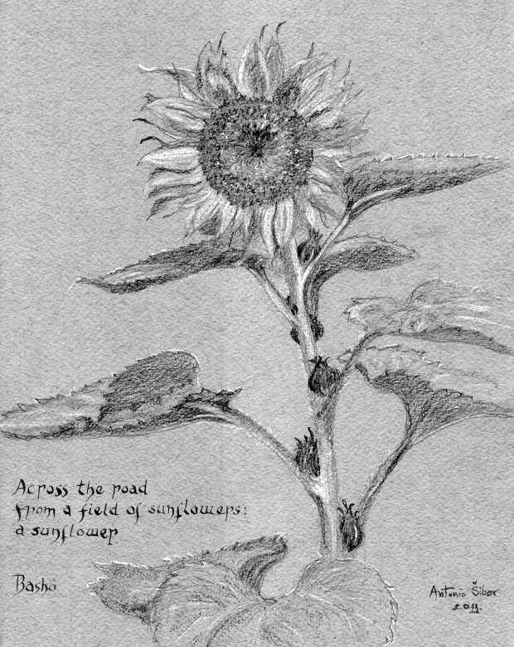
Haiku is said to be . . .
“a creative offering straight from the heart.”

Slide 18
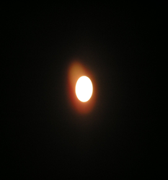
The Haiku’s appeal is . . .
“universal and lasting, and its scope and depth is representative of the human experience.”
What does this actually mean (in your own words)?

Slide 19
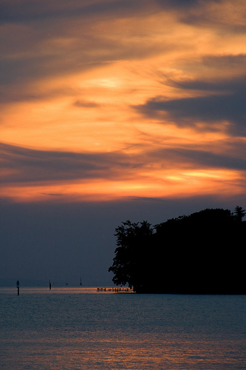
Haiku . . .
“show what it means to be human.”
How does this relate to the previous slide?

Slide 20
Form of haiku
Like the subjects of haiku, its form is equally simple.
It has only three lines.
Lines 1 and 3 have only five syllables.
Line 2 has seven syllables.
Western winds whip out
dead, dry leaves that hide by fence
Now it’s time to rake
5
7
5

Slide 21
Possible haiku subjects
Of course, the best way to be inspired is to write a haiku when you are out in nature:
The sea The river A sunset
The forest A path The moon
The backyard A cliff Stars
The desert A bird Rain
The mountains A moth Snow
The valleys A goat A rabbit
The farm Dew Storm
ANYTHING IN NATURE CAN INSPIRE YOU!

Slide 22
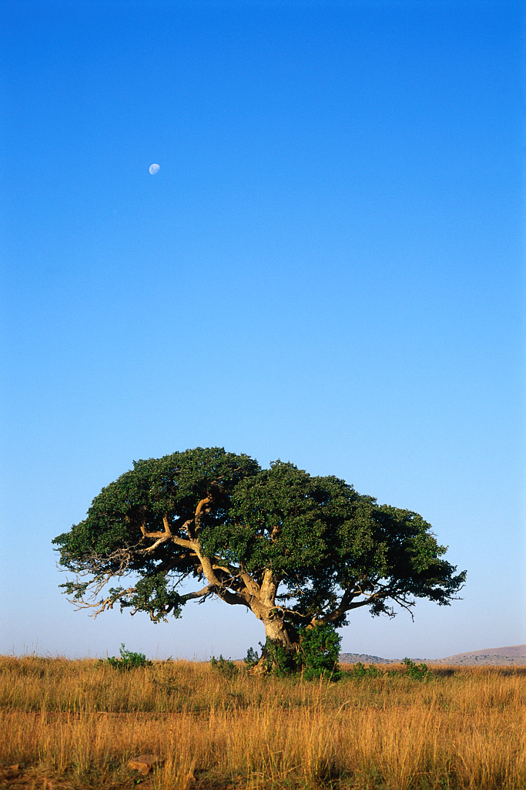

Slide 23
Bringing nature to the classroom
Open your writer’s notebook and get ready to take a nature fieldtrip within the classroom!
You will go around the world and experience scenes as they are occurring in nature!
As you experience each scene, jot down as many haiku as you can create!
These can count as letters in your Encyclopedia of an Ordinary Life.
Teacher will access the Sampler Videos of Nature to Inspire Haiku (Word Document with hyperlinks)

