Slide 1
Warm-Up Questions: What are some factors that have led to you being here right now? Why are memories so important?
It’s THURSDAY!!!!! Come on in & prepare to be amazed!

Slide 2
Warm-up questions Discuss warm-up responses Essential Question & Learning Goal Imagery & Figurative Language Read & listen to "Where I’m From” Poem Think, Pair, Share Gathering the Essentials Where Are You From? Exit Ticket
AGENDA:

Slide 3
Our Goal…….
Essential Question?
How do we measure whether life is fair or not?
Learning Goal:
You will be able to identify as well as use imagery in your writing.
Determine obvious & hidden meaning from a text through textual analysis.

Slide 4
Form & Structure
Form/ structure means the type of poem or the shape the poem takes (e.g. rhyming, repetition, etc…)
Examples:
haiku acrostic
free verse concrete poem
sonnet ballad
limerick narrative poetry

Slide 5
IMAGERY
Imagery means to use figurative language to represent objects, actions and ideas in such a way that it appeals to our physical senses.
Examples:
It was dark and dim in the forest. – The words “dark” and “dim” are visual images.
The children were screaming and shouting in the fields. - “Screaming” and “shouting” appeal to our sense of hearing or auditory sense.
He whiffed the aroma of brewed coffee. – “whiff” and “aroma” evoke our sense of smell or olfactory sense.
The girl ran her hands on a soft satin fabric. – The idea of “soft” in this example appeals to our sense of touch or tactile sense.

Slide 6
FIGURATIVE LANGUAGE
Figurative language uses words or expressions with a meaning that is different from the literal interpretation.
Tools:
A simile uses the words “like” or “as” to compare one object or idea with another to suggest they are alike.
Example: busy as a bee
The metaphor states a fact or draws a verbal picture by the use of comparison.
Example: You are what you eat.
An idiom is an expression whose meaning is not predictable from the usual meanings of its elements.
Example: She kicked the bucket.
A cliché is an expression that has been used so often that it has become trite and sometimes boring.
Example: Many hands make light work.
Personification is a figure of speech in which human characteristics are given to an animal or an object.
Example: My teddy bear gave me a hug.
Alliteration is the repetition of the same initial letter, sound, or group of sounds in a series of words. Alliteration includes tongue twisters.
Example: She sells seashells by the seashore.
Onomatopoeia is the use of a word to describe or imitate a natural sound or the sound made by an object or an action.
Example: snap crackle pop
Hyperbole is an exaggeration that is so dramatic that no one would believe the statement is true. Tall tales are hyperboles.
Example: He was so hungry, he ate that whole cornfield for lunch, stalks and all.

Slide 7
How to Annotate
1.Read the title and predict.
2.Circle or underline any unknown words.
3.Summarize every paragraph/stanza.
4.Read all subtitles/footnotes.
5.State the main idea.
→ Highlight or place an asterisk by
lines/phrases/words that support
the main idea.
https://www.youtube.com/watch?v=zy45es1HyO0

Slide 8
While you are reading & listening, annotate new words and phrases for discussion.
Let’s Break This Down….

Slide 9
We will now read & listen to the poem.
Where Mr. Torr
grew up.
Where Mr. Torr
grew up.
http://www.georgeellalyon.com/where.html

Slide 10
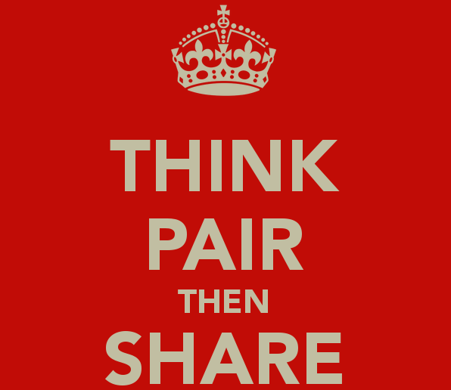
We have done the thinking……
Now it is time to do the next two steps. Take your worksheets and find a partner.
Compare your notes with those of your partner. Find out if you both selected the same things and discuss what you believe they mean.
Take time to discuss some of the things that you selected that your partner didn’t.
Finally, find the definition to three (3) of the words you did not know the meaning of.

Slide 11
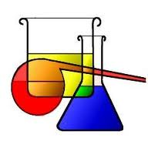
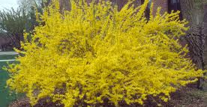
Things that stand out
CHEMICALS
NATURE
PEOPLE
Carbon tetrachloride, is the inorganic compound with the formula CCl4. It was used in fire extinguishers, as a refrigerant, and as a cleaning agent. It is a colorless liquid with a "sweet" smell that can be detected at low levels.
Clorox uses
The forsythia bush is native to several Asian countries but still grows in the U.S.
Elm trees are very popular in the U.S., often being planted along the sides of streets because they grow in a vase shape.
Artemus & Billie – possibly parents or grandparents
Imogene & Alafair – These were ladies from here neighborhood. Imogene gave out the best Halloween treats & Alafair had a beauty shop in her garage. http://www.answers.com/Q/What_is_Imogene_in_the_poem_Where_I'm_From_by_George_Ella_Lyon

Slide 12
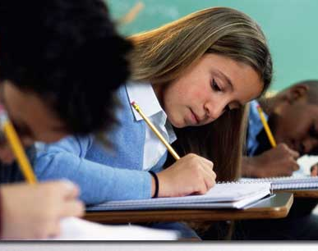
Now its your turn!!!
Using the poem template, create your own poem about where you are from.
Once you have completed the template, create a rough draft according to the directions provided. Have a friend edit your poem for correct spelling and punctuation use.
When you have finished the rough draft, find pictures, word phrases, etc… in the magazines to create your pictogram that visually represents your poem.
Finally write/type a final draft of your poem.

