Slide 1
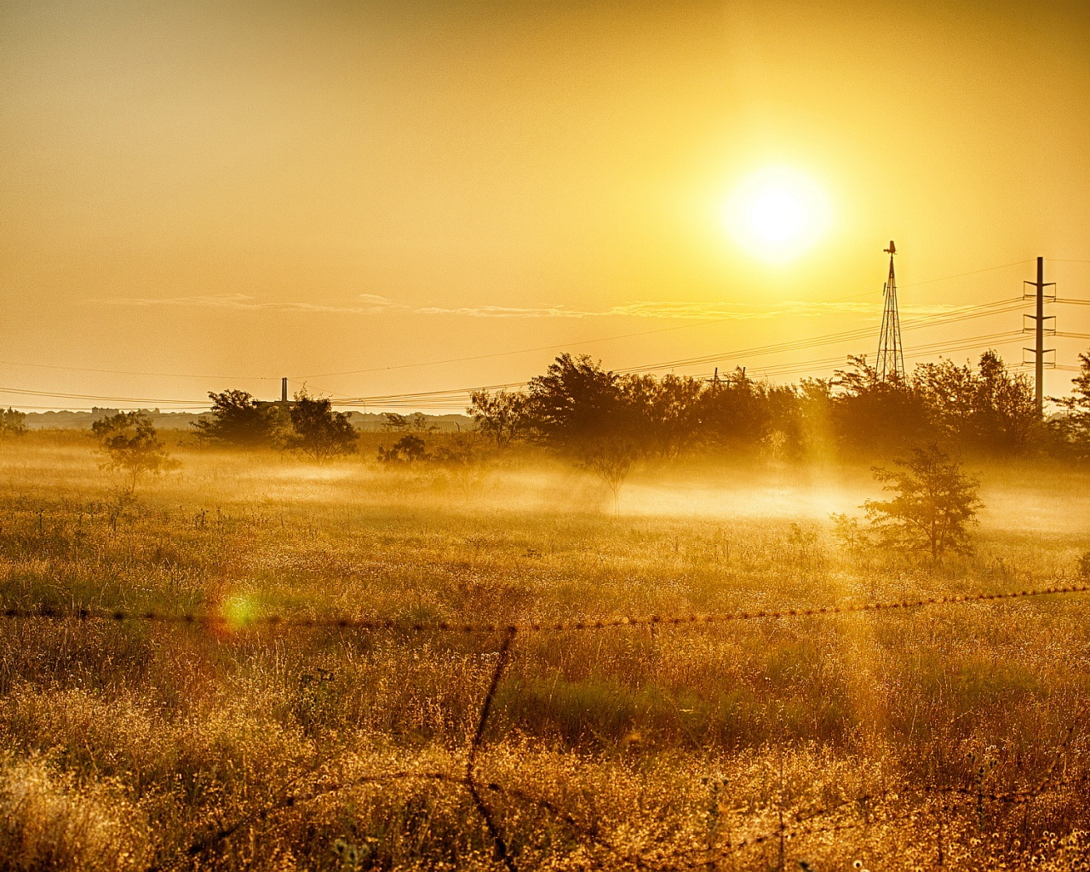
HAPPY TUESDAY!! – 9/2/2014
Bell Ringer: Life Is Not Fair Introduction
SSR
Record New Vocabulary
Read “The Sun Goes Down on Summer”
Pair Share
Group Wrap-Up/Reflection
Essential Question: How do we measure whether life is fair or not?
Learning Objective: Students are able to determine obvious and hidden meaning from a text through textual analysis.

Slide 2
BELL RINGER
Place the words below in the column where you believe they belong. Based on your classifications, what does it mean to be “fair” or “unfair”?
Parent Teacher Referee Friend Lawyer Judge Media Police Officer Sibling Coach
FAIR | UNFAIR
Parent | Police Officer

Slide 3
Vocabulary
Poetry – written or spoken rhythm that expresses beautiful, imaginative, or elevated thought
Verse – a line in a poem
Heap – a great quantity or number; a pile
Form/Structure – type of poem or the shape the poem takes (e.g. rhyming, repetition, etc…)

Slide 4
Vocabulary
5. Analyze – to examine carefully to bring out the critical elements; give the idea of
6. Auger – a boring tool
7. Stanza – a group of lines in a poem that are usually similar in length and pattern and are separated by spaces

Slide 5
Vocabulary
8. Headlong – without delay; hastily
9. Glistening – a sparkling shine
10. Speaker – person assumed to be speaking in the poem

Slide 6
“The Sun Goes Down on Summer” by Steve Lawhead
First Time: Read “The Sun Goes Down on Summer” silently by yourself.
http://www.tnellen.com/cybereng/poetry/summer.html
Second Time: Read the poem again AND highlight/underline AT LEAST TWO verses that resonate with you or relate to you personally.
Third Time: Listen while I read the poem and highlight/underline another verse that resonates with you.

Slide 7
Pair Share and Group Wrap-Up
Pair up with someone sitting next to you and do the following:
Share the verses you highlighted/underlined with your partner.
Explain WHY you marked them.
Think about how the speaker of the poem is feeling and what he is trying to say.

Slide 8
Reflection
What are one or two things you would like to improve upon this year?
How does the theme of this poem relate to our unit theme, Life Is Not Fair?

